Slide 1
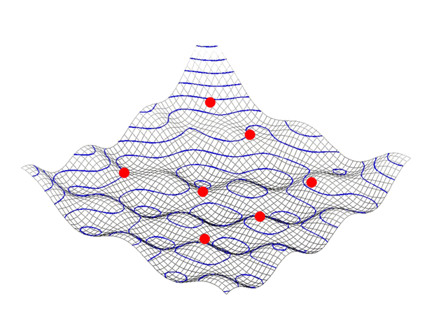
CROWD CONTROL SYSTEM…
BY PURVA BUNDELA.

Slide 2
INTODUCTION
The PSO algorithm was first described in 1995 by James Kennedy and Russell C. Eberhart inspired by social behavior of bird flocking or fish schooling.
PSO is an artificial intelligence (AI) technique that can be used to find approximate solutions to extremely difficult or impossible numeric maximization and minimization problems.
Hypotheses are plotted in this space and seeded with an initial velocity, as well as a communication channel between the particles.
Simple algorithm, easy to implement and few parameters to adjust mainly the velocity.

Slide 3
Problem proposed
The rapid increase of population, the number of disasters has increased sharply
A security system which can ensure all personnel evacuation needs to be established urgently.
An optimized design scheme should be considered in crowd management, which can enhance crowd evacuation performance.
Even in the situation of safety measure failures, available people assembly and evacuation can also be considered as the final safety shelter to avoid the disaster and the economic loss.
Thus, the design of efficient evacuation model has become one of the hottest research areas of several industries

Slide 4
Solution to the problem
. According to the mechanisms of PSO, each person (particle) in the crowd (swarm) can adopt the information to search a path from the initial position to the specified target (optimum) automatically
we present a uniform conceptual model based on particle swarm optimization (PSO) to simulate the motion of all persons in a crowd according to the analogy between a swarm and a crowd.
A person can be considered as a particle, which would like to find a way to reach the best solution.
The particles update their velocity and position according to individual behavior, the behavior of the whole group, and the best individual experience in the neighborhood

Slide 5
Steps for Pso implementation
Create the random particles which will act as human in the region.
Initialize the human particles with random positions and velocities.
Evaluate the fitness value of system
Calculate system constraints for each particle and totalGo back to step-(3) and repeat all steps until system constraints are met Here
error
Compare the individual fitness value of each particle to its previous value, if it is better than previous one, replace with new value i.e. local best position otherwise remain the same.
The position of particle having lowest fitness value is global best value.
Update position and velocity of particle according to Step-(1).
Go back to step-(3) and repeat all steps until system constraints are met Here

Slide 6
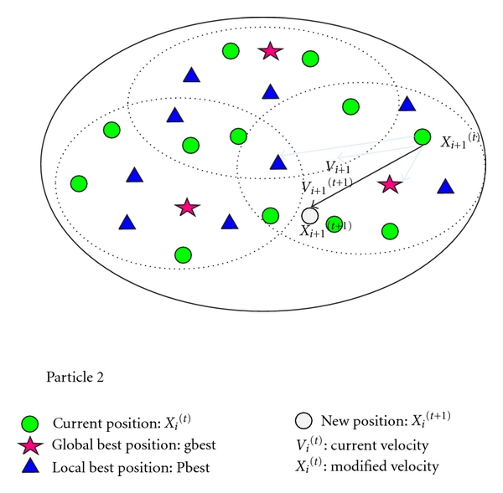
Particles explaination

Slide 9
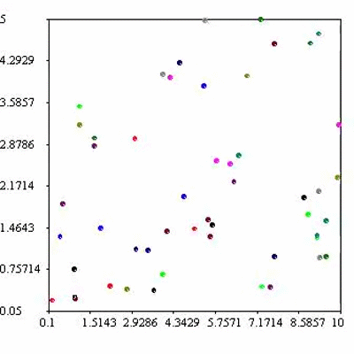

Slide 10
Conclusion
This project mainly studies how to simulate the process of passengers’ evacuation under the circumstance of emergency evacuation and establishes the simulation model of the passengers based on the neighborhood particle swarm optimization algorithm.
In this project, we consider the particles in the swarm as the individuals in evacuation, and the behaviors of the particles are directed by their own learning abilities, the perception abilities of environment, and the social attributes, which can simulate the real process of evacuation.

Slide 11

Thank you!!

